Slide 1
Car Accident severity
Capstone project

Slide 2
Introduction
Predict the severity of a car accident
To use by 911 to decide whether to send only police or also ambulance and/or fire brigade
Severity code based on the answers at a few simple questions. Easy to answer by callers

Slide 3
Data
SEVERITYCODE is the dependent variable
WEATHER, ROADCOND, LIGHTCOND and ADDRTYPE are the independent variables
Later added: VEHCOUNT and JUNCTIONTYPE
The source of the data: https://s3.us.cloud-object-storage.appdomain.cloud/cf-courses-data/CognitiveClass/DP0701EN/version-2/Data-Collisions.csv

Slide 4
Methodology
Checked wheter all records had data for the formentioned variables
Replaced NAN by ‘Unknown’
Changed descriptions by values
Because we have a classification problem and we’re dealing with categorical variables, the model used is Logistic Regression

Slide 5

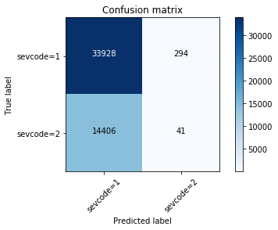
results
Method | Score
Jaccard | 0.70
Log_loss | 0.59
F1 | 0.58

Slide 6
RESULTS
The majority of the predictions is SEVERITYCODE 1
Just 41 cases of the 14447 where the SEVERITYCODE 2 is predicted right
Added VEHCOUNT
Now 889 cases where the SEVERITYCODE 2 is predicted right
But still a low result

Slide 7
Observations and recommendations
Low result
Improving by adding more independent variables
Some variables to complex to add, for instance LOCATION
Adding more independent variables improves the model but by adding complexity for 911
Try to add one or more variables and check if this improves the model further

Slide 8
conclusion
Not an easy assignment
Learned a lot
Still a lot to learn

